Slide 1


Hii,
Iam Siddhika
Welcome to Power BI Series
Part -85

Slide 2


Today Content
I’m very excited to dive into this with you all!
Are you ready to enhance your data visualization skills?
VISUALIZING DATA
ROW-LEVEL SECURITY (RLS)
Introduction Static RLS

Slide 3


ROW-LEVEL SECURITY (RLS)
lets go for each RLS clearly
RLS feature allows you to restrict access to data for specific users.
This means that when a report is shared with different users, each user will only see the data relevant to them based on the rules you set.
It's useful when you want to ensure that certain users can only view specific rows of data, rather than the entire dataset.
TYPES OF RLS:
Static RLS: Predefined filters applied to the data for specific users or roles.
Dynamic RLS: Filters adjust dynamically based on the identity of the logged-in user, providing a personalized view of the data.

Slide 4

1.STATIC RLS
see next
slide ..
In Static RLS, specific roles are created with fixed filters that apply to all users assigned to that role.
This is useful when data access doesn't change based on the individual but is role-based (e.g., managers only see data for their department).
Use Case Example:
Suppose you have a Sales dataset with Table sales territory with columns country, region etc. You want users from the "Germany" country to only see data for that country.

Slide 5

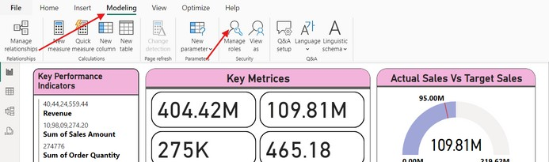
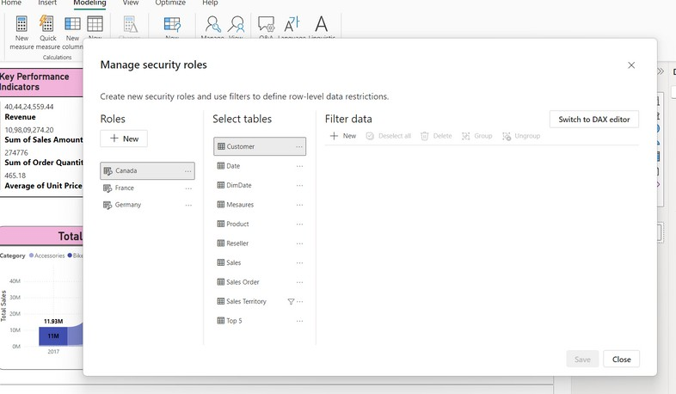
Steps to Set Up Static RLS
1. Go to the Modeling Tab:
Open your Power BI report.
Click on the “Modeling” tab and select “Manage Roles.”
do along with
me

Slide 6
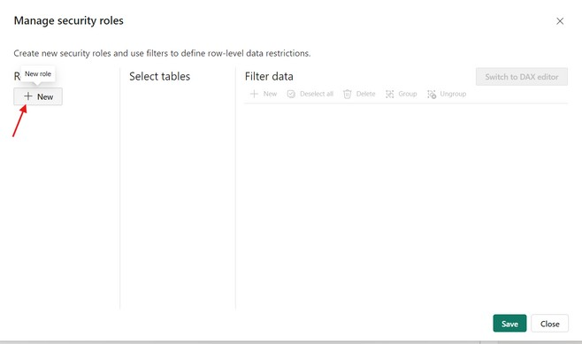

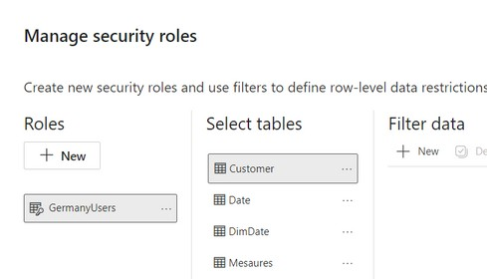

2.Create Roles:
Click on "New" “GermanyUsers”.
and give your role a name, like
Easy..see
next

Slide 7
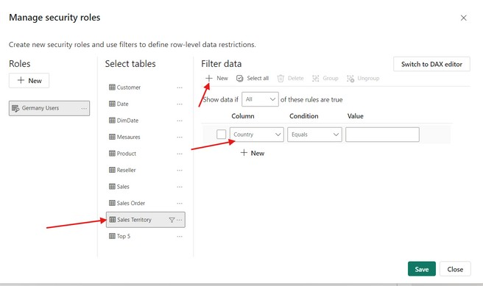
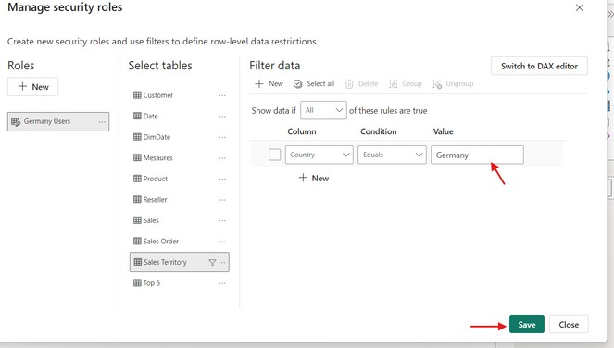
3.Set the Rule:
Click on the Sales Territory table, Cilck on New on Filter Data, Select Column
try it..
Type Germany Name In Value place.
Do for all other countries by clicking on New.
Click on Save

Slide 8
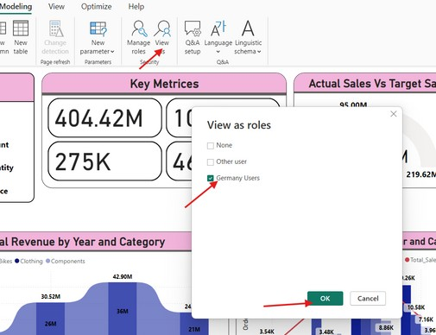
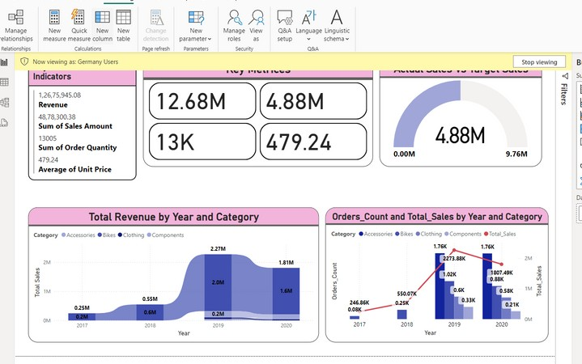
4.Test the Role:
Use the View As Role feature to test the role. and see the report as an "Germany" user by click on GermanyUsers.
Go and
try..
Varsha Chitikaneni

Slide 9

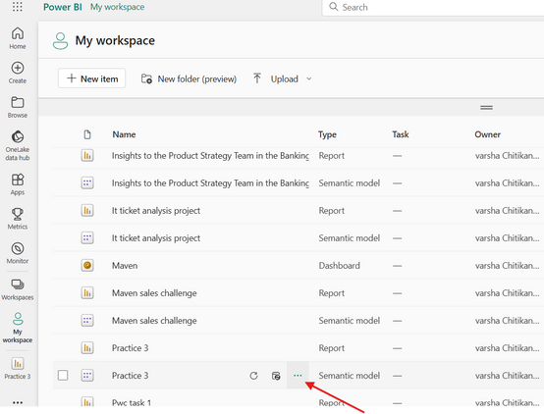
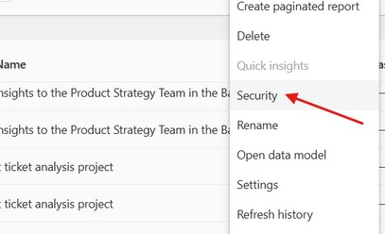
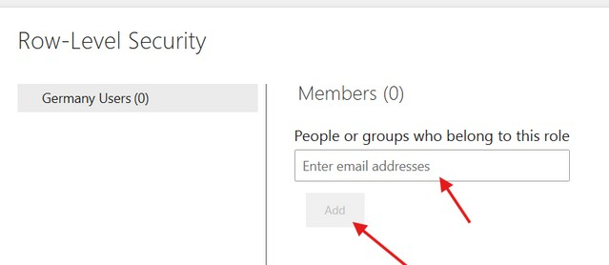
5.Assign Users to Roles (Service Level):
Its on PBI
After publishing the report to Power BI Service, go to the our file dataset on workspace. Click on 3 dots
click on "Security” from all the options. assign users to the GermanyUsers or Other role, based on their access level.
Service.
I dont have any
mails to add. so
I have not done
here you can add the emails of Germany users.
so that if someone opens data with that mail ,he can only see Germany data

Slide 10


Thank you for joining me today to learn about Part -85 of Power BI!
Remember, Effective data visualization is crucial for turning data into meaningful insights and compelling narratives with Power BI.
Stay tuned for more insights and tips on Power BI in our next Series.
Follow
Siddhika Shah

